Slide 1
AlKarkh University of Science College of science First year level
General chemistry Labs
Supervisor: Dr. Mohammed Abdul Baset Assistant: Anssam Dhaher Huessin
Lab -9-
Separation of I Group cations (Ag⁺, Pb²⁺, Hg₂²⁺)
27

Slide 2
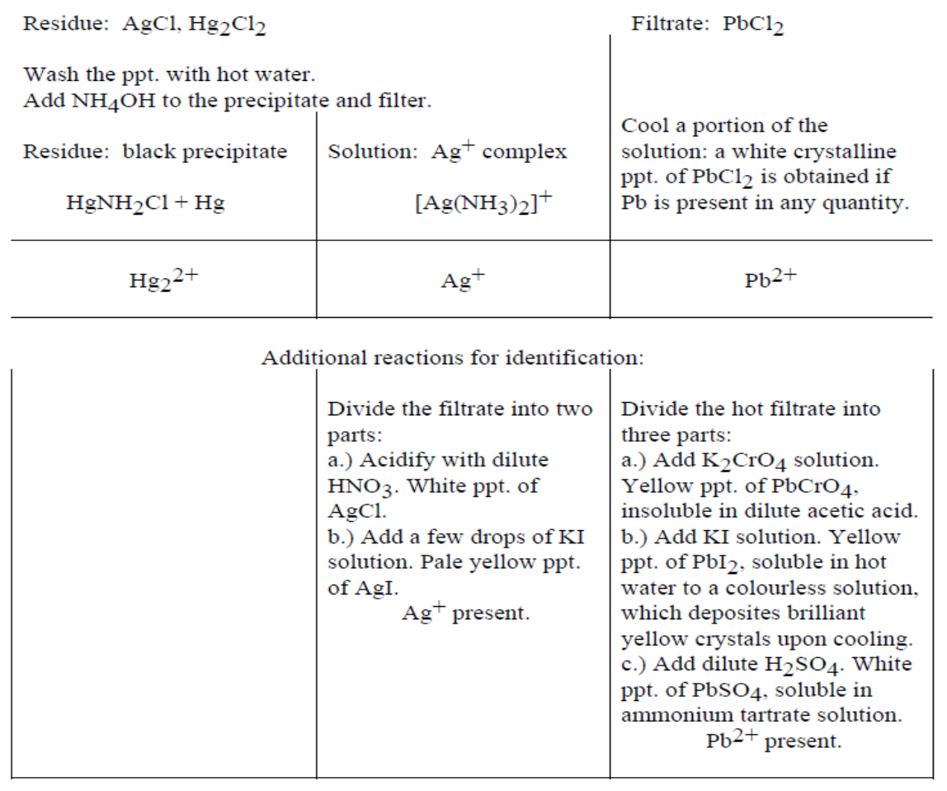
2. Procedure:
Take 2 ml of unknown for identification and add drops of 6M HCl. You should obtain white precipitate (Precipitate A).
Transfer the precipitate to a small beaker, and boil with 1-5 ml water. Filter hot. ³ ⁴
3. Results:
4. Discuss:
a- PbCl2 soluble in hot water.
b- Presence of Silver ion (Ag+) in the unknown solution.
c- Divide the colorless filtrate solution of Ag(NH₃)₂Cl into two parts.
28

Slide 3
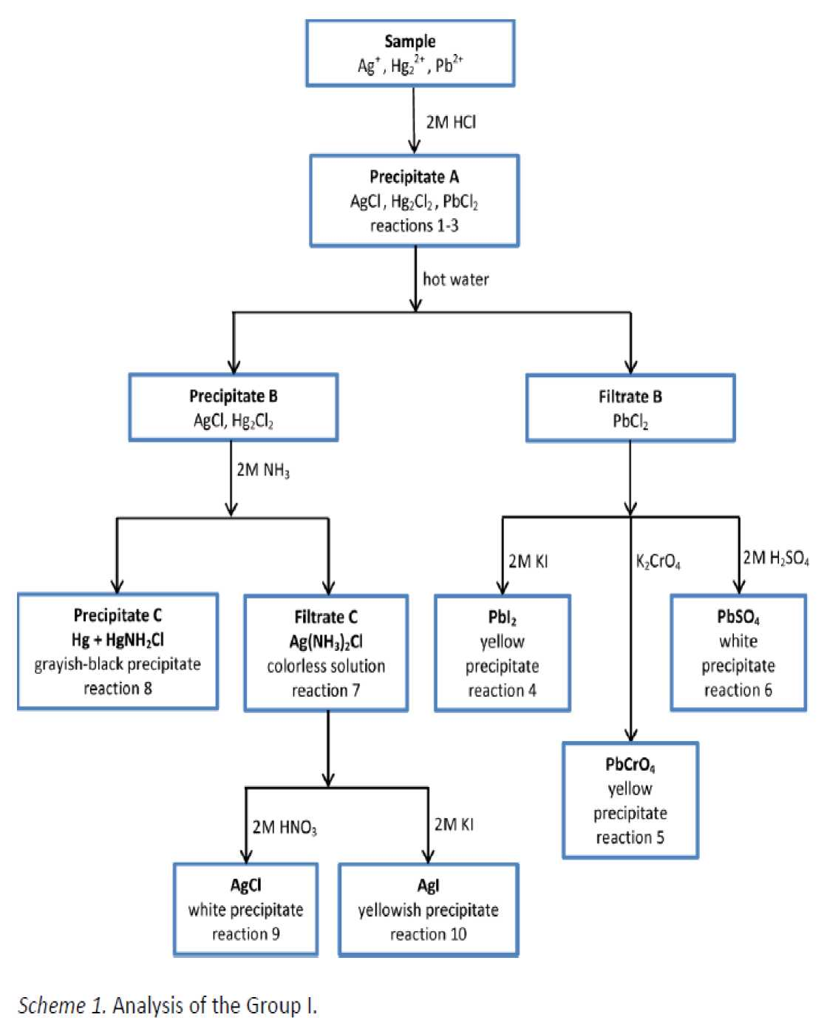
29

